Slide 1
Bitwise operators

Slide 2
Bitwise operation
A | B | ~A | A&B | A|B | A^B
1 | 1 | 0 | 1 | 1 | 0
1 | 0 | 0 | 0 | 1 | 1
0 | 1 | 1 | 0 | 1 | 1
0 | 0 | 1 | 0 | 0 | 0

Slide 3
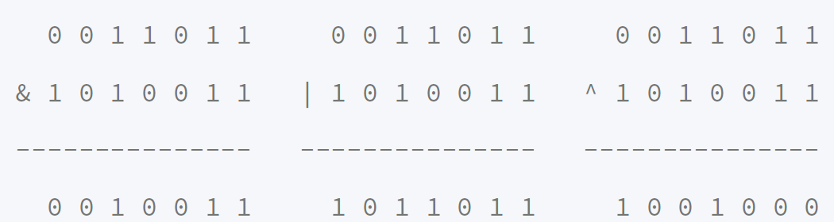
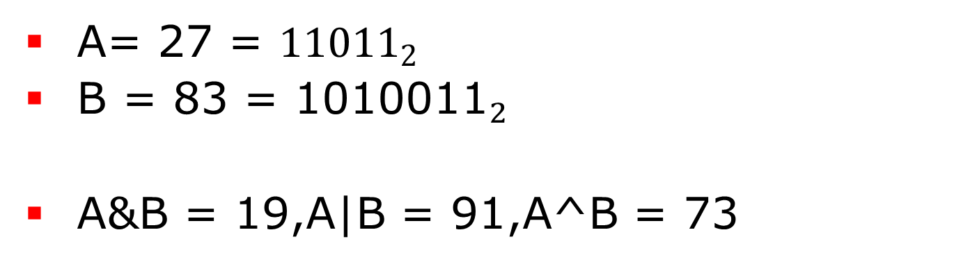
Bitwise operation
A= 27 = ${11011}_{2}$
B = 83 = ${\text{1010011}}_{2}$
A&B = 19,A|B = 91,A^B = 73

Slide 4

NOT
A = 83 = ${\text{1010011}}_{2}$
~A = ${10101100}_{2}$ (8 bit)
~A = 11111111 11111111 11111111 ${10101100}_{2}$ (32 bit)

Slide 5
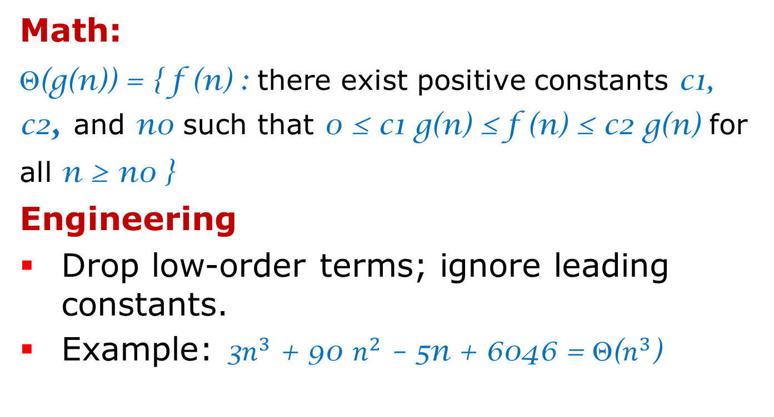
Shift Left
1 << 0 = 1
1 << 1 = 2 = ${10}_{2}$
1 << 2 = 4 = ${100}_{2}$
1 << 3 = 8 = ${1000}_{2}$
1 << 4 = 16 = ${10000}_{2}$
3 << 3 = 24 = ${11000}_{2}$
5 << 10 = 5120 = ${1010000000000}_{2}$

Slide 6
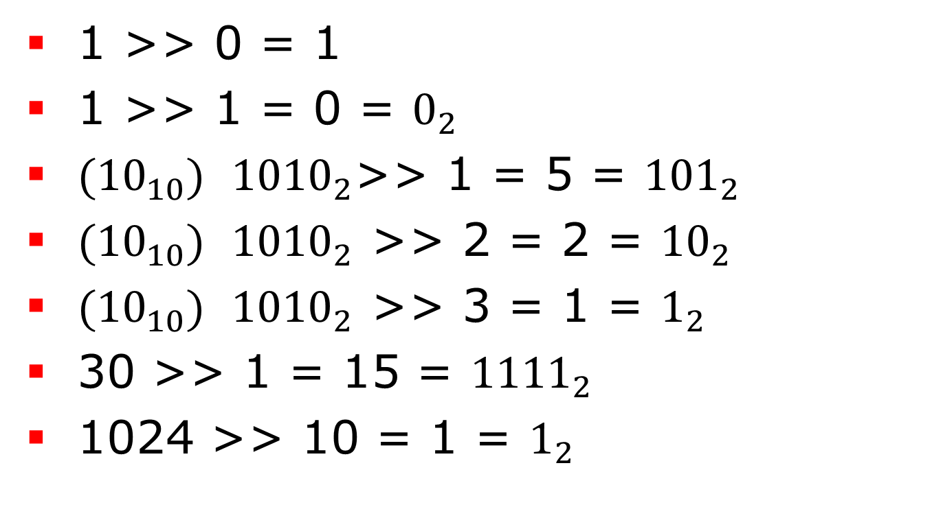
Shift Right
1 >> 0 = 1
1 >> 1 = 0 = $0_{2}$
${(10}_{10})$ ${1010}_{2}$>> 1 = 5 = ${101}_{2}$
${(10}_{10})$ ${1010}_{2}$ >> 2 = 2 = ${10}_{2}$
${(10}_{10})$ ${1010}_{2}$ >> 3 = 1 = $1_{2}$
30 >> 1 = 15 = ${1111}_{2}$
1024 >> 10 = 1 = $1_{2}$

Slide 7

Bitwise Operators
A<<B = A * $2^{B}$
A >> B = A / $2^{B}$
(A+B) /2 = (A + B) >>1
FIND ODDS
if(N%2==1)
if(N&1)

Slide 8

Packing/unpacking
int pack(char a, char b, char c, char d)
{
int p = a;
p = (p << 8) | b;
p = (p << 8) | c;
p = (p << 8) | d;
return p;
}
char unpack(int p, int k)
{
int n = k * 8;
unsigned mask = 255;
mask <<= n;
return ((p & mask) >> n);
}
Notes:
#include <limits.h>
int pack(char a, char b, char c, char d)
{
int p = a; /* p will be packed with a, b, c, d */
p = (p << CHAR_BIT) | b;
p = (p << CHAR_BIT) | c;
p = (p << CHAR_BIT) | d;
return p;
}
char unpack(int p, int k) /* k = 0, 1, 2, or 3 */
{
int n = k * CHAR_BIT; /* n = 0, 8, 16, or 24 */
unsigned mask = 255; /* low-order byte */
mask <<= n;
return ((p & mask) >> n);
}
void bit_print(int a)
{
int i;
int n = sizeof(int) * CHAR_BIT; /* in limits.h */
int mask = 1 << (n - 1); /* mask = 100...0 */
for (i = 1; i <= n; ++i) {
putchar(((a & mask) == 0) ? '0' : '1');
a <<= 1;
if (i % CHAR_BIT == 0 && i < n)
putchar(' ');
}
}
void main (void) {
int num=3;
int i;
int ARV=pack('a','b','c','d');
printf("abcd = ");
bit_print(ARV);
putchar('\n');
printf("abcd = ");
for(i=0;i<4;i++){
printf("%c", unpack(ARV, i));
}
putchar('\n');
}

Slide 9
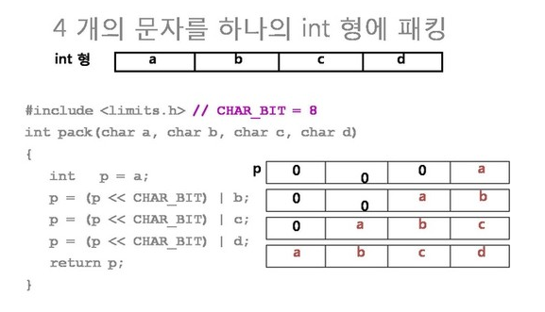
Packing/unpacking

Slide 10
Packing/unpacking
01100001 | 01100010 | 01100011 | 01100100
11111111
char unpack(int p, int k)
{
int n = k * 8;
unsigned mask = 255;
mask <<= n;
return ((p & mask) >> n);
}
k = 0 d

Slide 11
Packing/unpacking
01100001 | 01100010 | 01100011 | 01100100
11111111
char unpack(int p, int k)
{
int n = k * 8;
unsigned mask = 255;
mask <<= n;
return ((p & mask) >> n);
}
k = 0 d
k = 1 c

Slide 12
Packing/unpacking
01100001 | 01100010 | 01100011 | 01100100
11111111
char unpack(int p, int k)
{
int n = k * 8;
unsigned mask = 255;
mask <<= n;
return ((p & mask) >> n);
}
k = 0 d
k = 1 c
k = 2 b

Slide 13
Packing/unpacking
01100001 | 01100010 | 01100011 | 01100100
11111111
char unpack(int p, int k)
{
int n = k * 8;
unsigned mask = 255;
mask <<= n;
return ((p & mask) >> n);
}
k = 0 d
k = 1 c
k = 2 b
k = 3 a

Slide 14
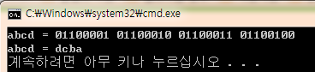
Packing/unpacking
char unpack(int p, int k)
{
int n = k * 8;
unsigned mask = 255;
mask <<= n;
return ((p & mask) >> n);
}

Slide 15
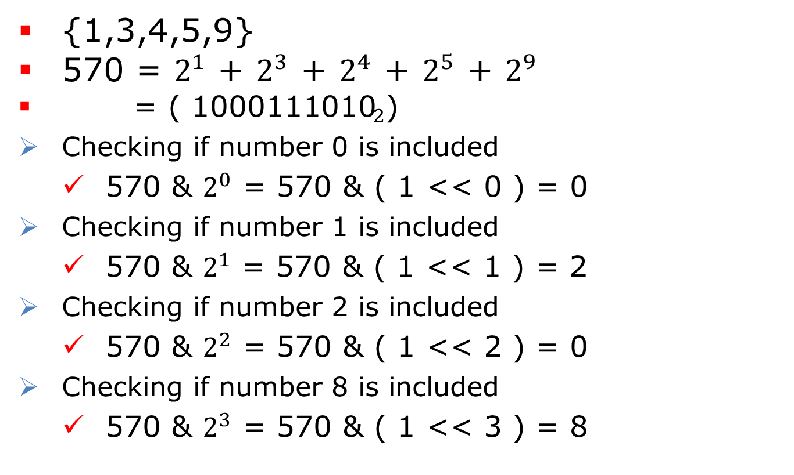
BitMask
{1,3,4,5,9}
570 = $2^{1}$ + $2^{3}$ + $2^{4}$ + $2^{5}$ + $2^{9}$
= ( ${\text{1000111010}}_{2}$)
Checking if number 0 is included
570 & $2^{0}$ = 570 & ( 1 << 0 ) = 0
Checking if number 1 is included
570 & $2^{1}$ = 570 & ( 1 << 1 ) = 2
Checking if number 2 is included
570 & $2^{2}$ = 570 & ( 1 << 2 ) = 0
Checking if number 8 is included
570 & $2^{3}$ = 570 & ( 1 << 3 ) = 8

Slide 16
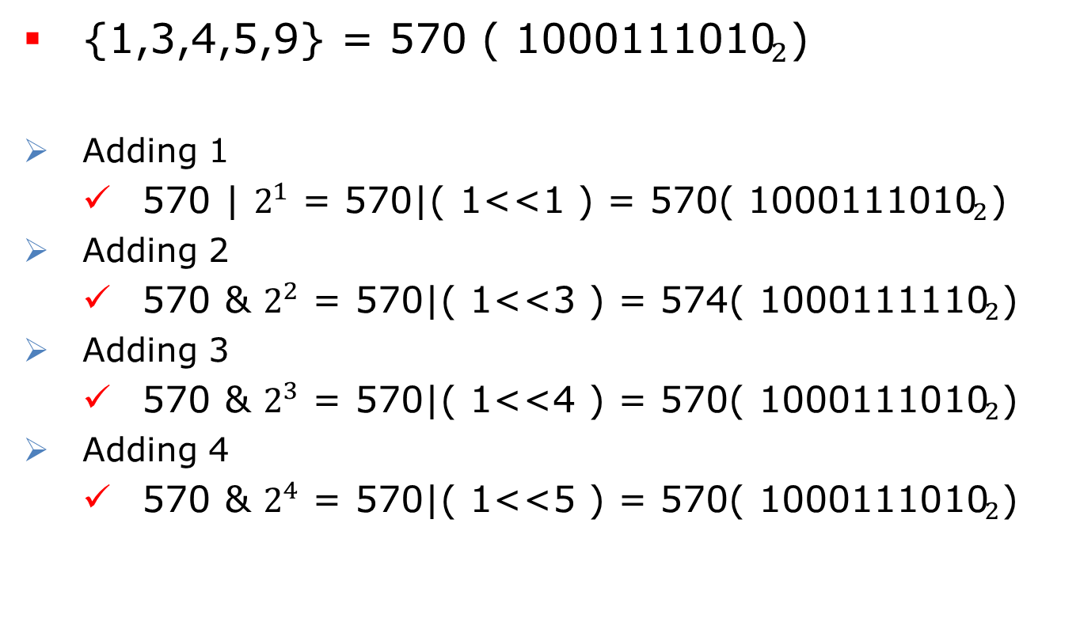
BitMask
{1,3,4,5,9} = 570 ( ${\text{1000111010}}_{2}$)
Adding 1
570 | $2^{1}$ = 570|( 1<<1 ) = 570( ${\text{100011101}\text{0}}_{2}$)
Adding 2
570 & $2^{2}$ = 570|( 1<<3 ) = 574( ${\text{1000111}\text{1}\text{10}}_{2}$)
Adding 3
570 & $2^{3}$ = 570|( 1<<4 ) = 570( ${\text{1000111010}}_{2}$)
Adding 4
570 & $2^{4}$ = 570|( 1<<5 ) = 570( ${\text{1000111010}}_{2}$)

Slide 17
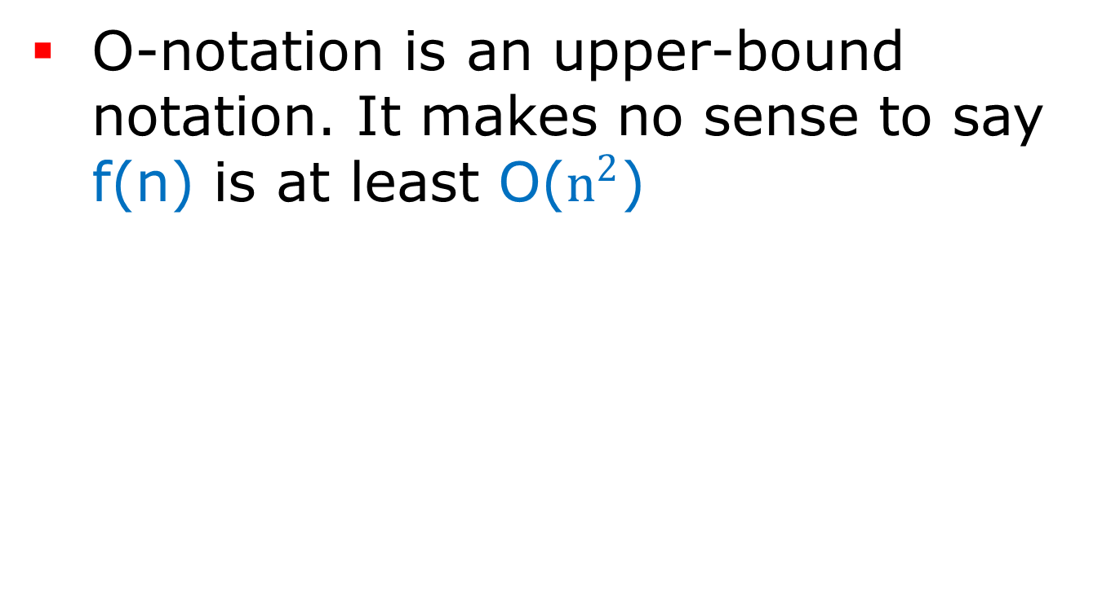
BitMask
{1,3,4,5,9} = 570
Removing 1
570 & ~$2^{1}$ = 570 & ~( 1<<1 ) = 568( ${\text{10001110}\text{0}\text{0}}_{2}$)
Removing 2
570& ~$2^{2}$ = 570& ~( 1<<2 ) = 570( ${\text{10001110}\text{1}\text{0}}_{2}$)
Removing 3
570& ~$2^{3}$ = 570& ~( 1<<3 ) = 562( ${\text{100011}\text{0}\text{0}\text{1}\text{0}}_{2}$)
Removing 4
562& ~$2^{4}$ = 562 & ~( 1<<5 ) = 546( ${\text{10001}\text{0}\text{1010}}_{2}$)

Slide 18
BitMask
Adding i
s | ( 1 << i )
Cheking i
s & ( 1 << i )
Removing i
s & ~( 1 << i )
Toggling i
s ^& ~( 1 << i )

Slide 19
Swap (using XOR operator)
int a = 3, b = 7; //a = 0011, b = 0111
a = a ^ b; //a = 4
a = a ^ b; //a = 3

Slide 20
Swap (using XOR operators)
int a = 3, b = 7; //a = 0011, b = 0111
a = a ^ b; //a = 4
b = b ^ a; //b = 3
a = a ^ b; //a = 7
Short Coding
a ^= b ^= a ^= b;

